Slide 1

DOHMH NEW YORK CITY RESTAURANT INSPECTION RESULTS
BRENDA VITAL

Slide 2

Research Questions
How do inspection grades compare across all 5 boroughs?
What are the top 10 cuisines across all 5 boroughs?
What are the top 5 restaurants that have the most violations?
Which borough has the most rodent violations?
What are the top 5 violations across all boroughs?

Slide 3
DATA SOURCE & MOTIVATION
DOHMH New York City Restaurant Inspection Results from NYC Open Data
August 1st,2014 – present
Updated daily
The dataset contains 212,000 rows and 27 columns
Features included in the dataset:
Name of establishment, street, zip code, borough, type of cuisine, date of inspection, violation description, violation code, grade
Motivation

Slide 4
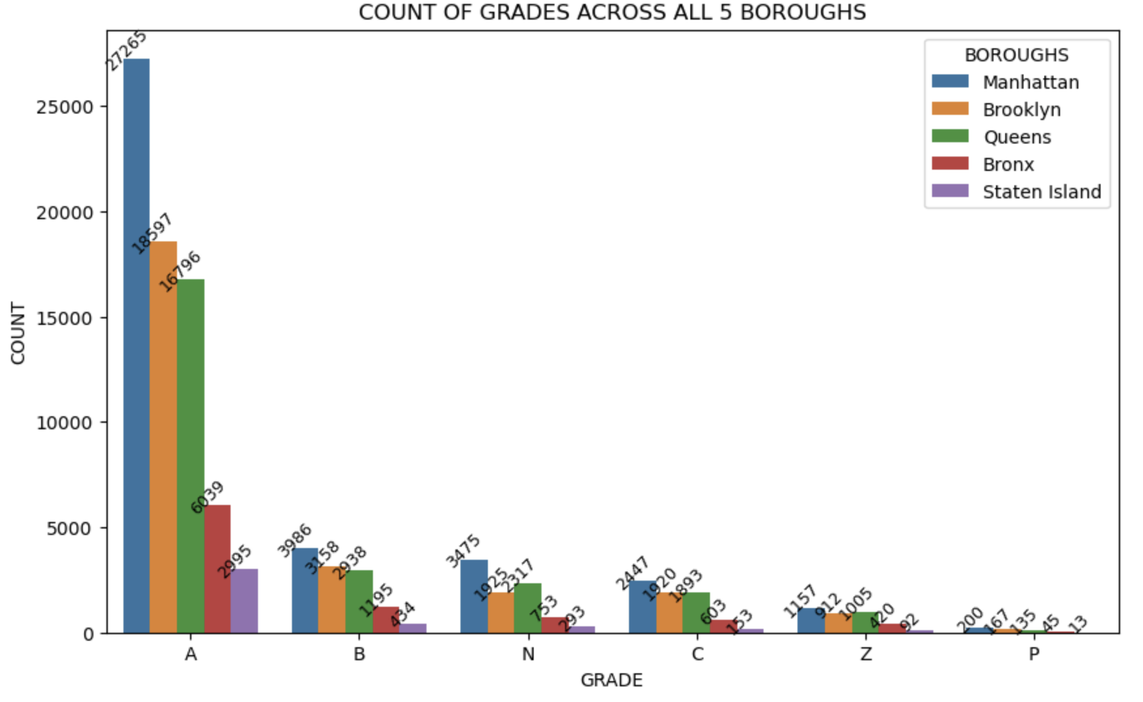
METHODOLOGIES/VISUALIZATION
Python libraries
Pandas
Matplotlib
Seaborn
Types of visualizations
Bar graph/horizontal bar graph
Data cleaning & transformations
Dropping rows with N/A values
Dropping columns
Renaming columns
Creating new dataframes
Simple statistics

Slide 5
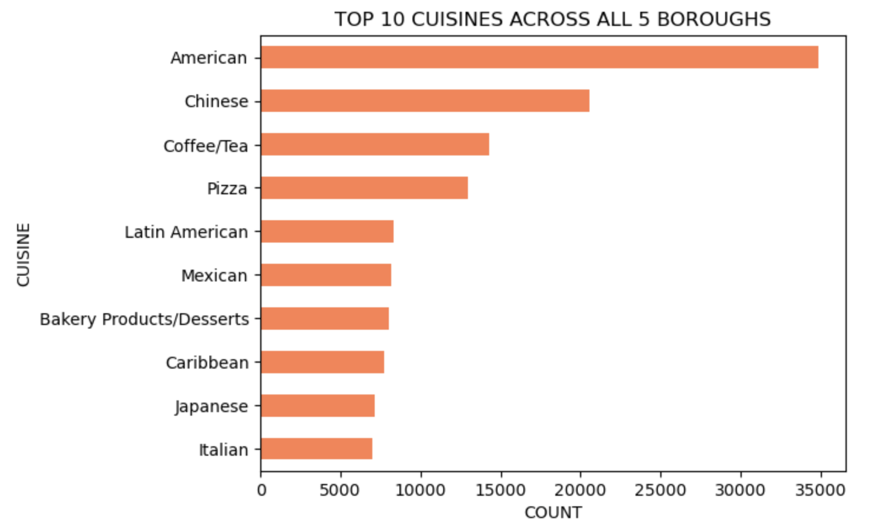
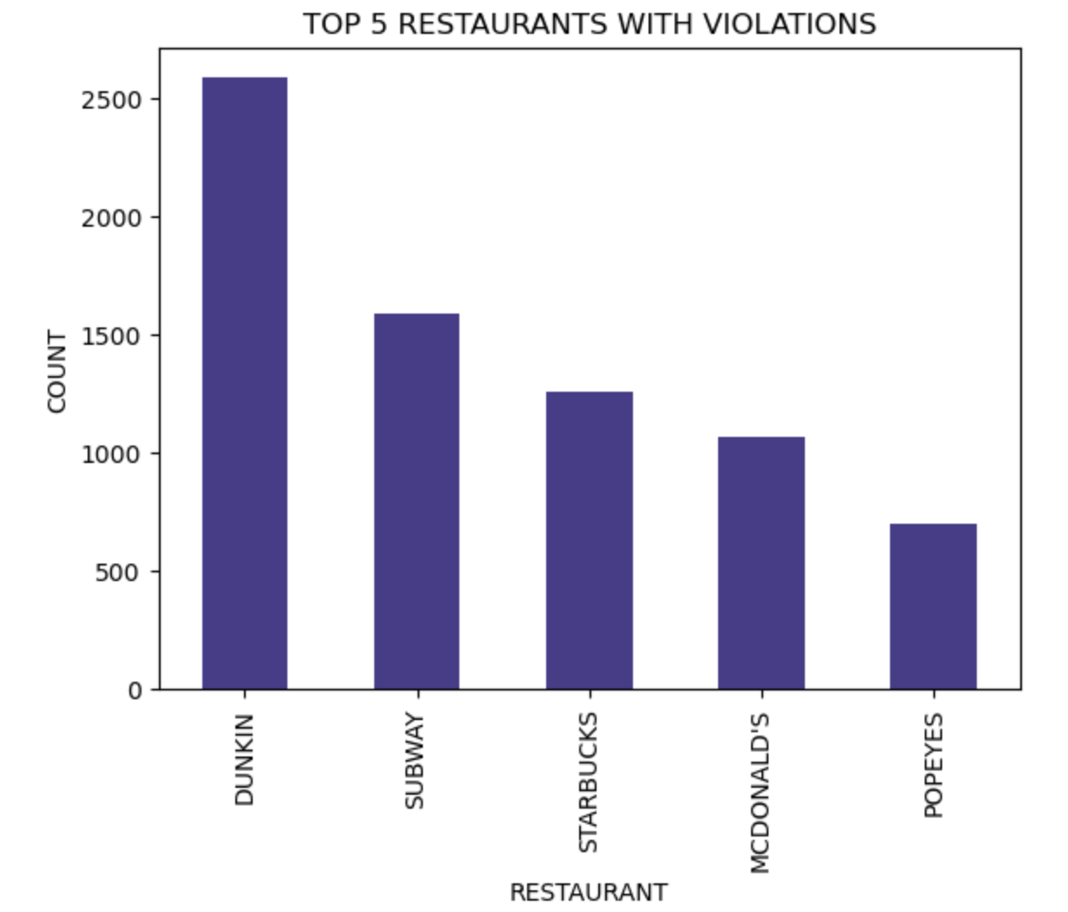
VISUALIZATIONS CONTINUED

Slide 6
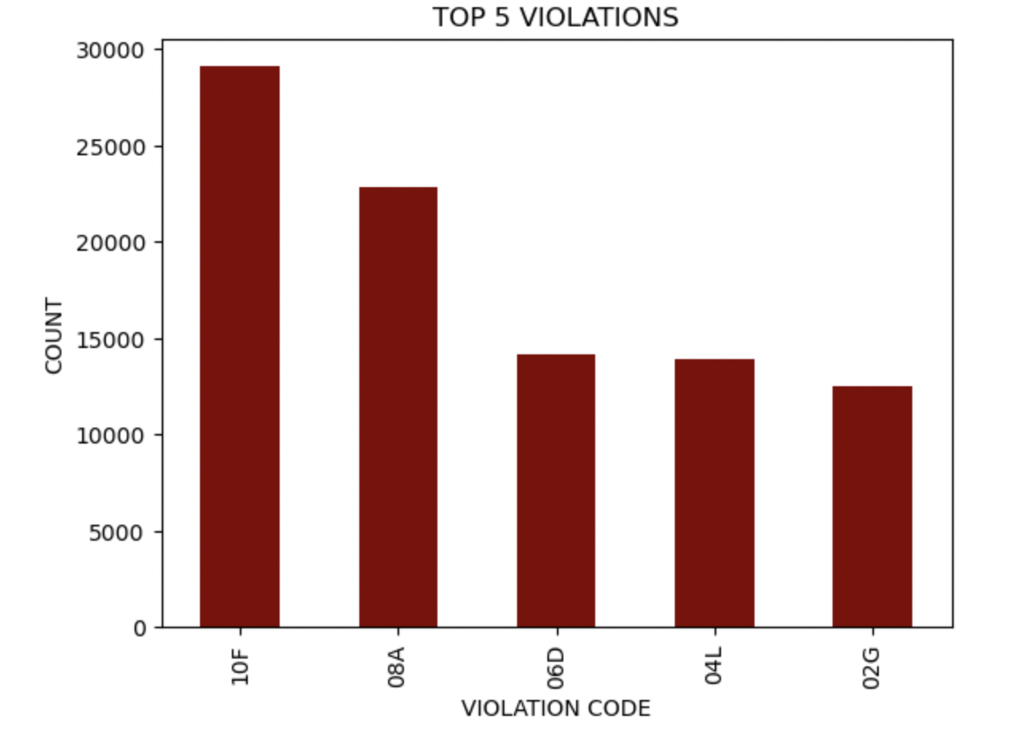
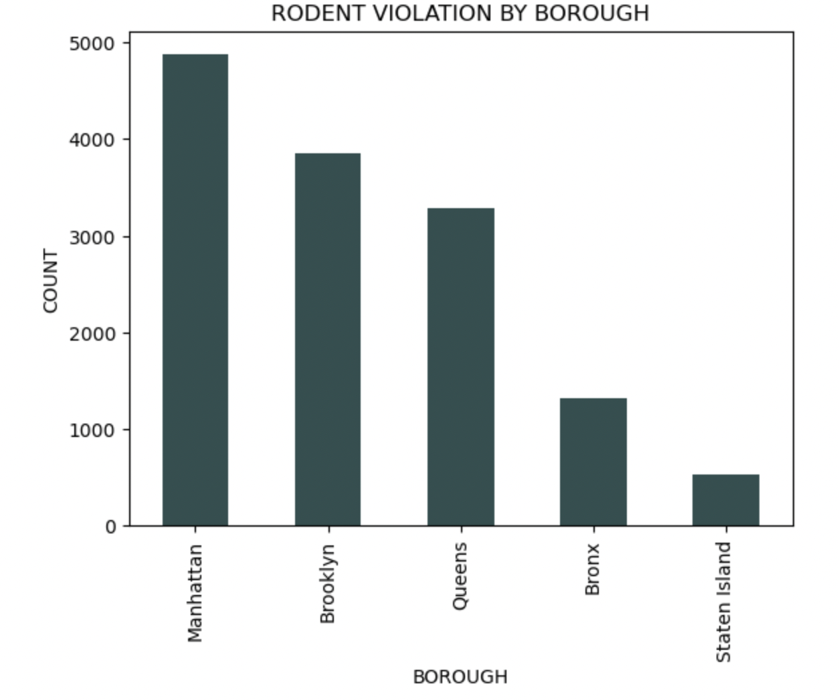
VISUALIZATIONS CONTINUED

Slide 7

FINDINGS & FURTHER THOUGHTS
Most restaurants across the boroughs were given an A for inspection.
“American” food was a top choice for cuisine
Dunkin Donuts was the restaurant with the most violations
Flawed data?

